Slide 1
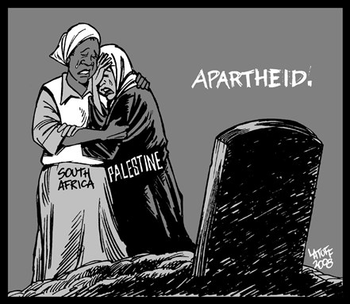
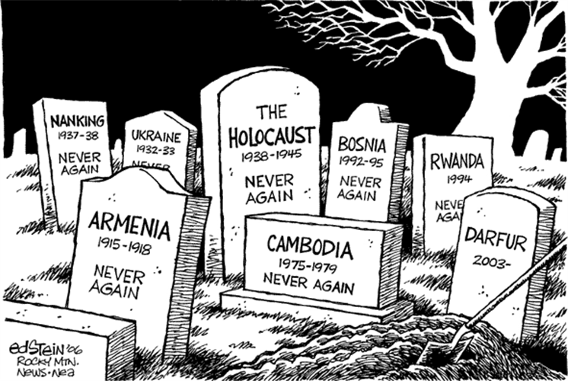
Using the images above, what do you think today’s lesson is about?
Discuss in small groups

Slide 2
Comparing Palestine-Israel with other places

Slide 3
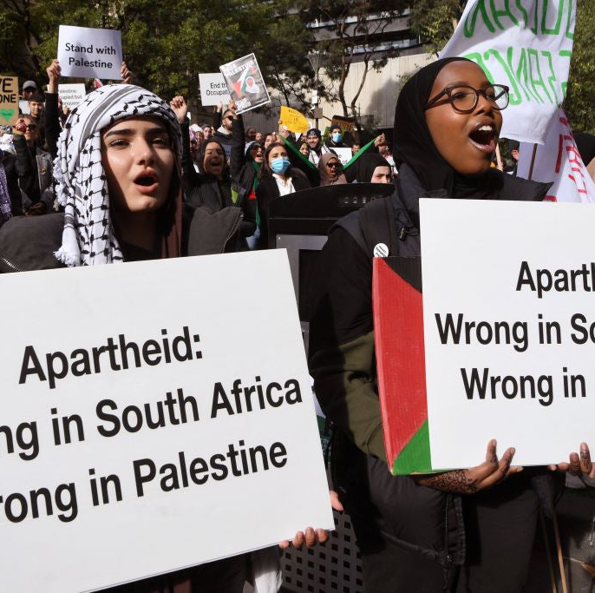
What comparisons can be drawn between Palestine-Israel and elsewhere?
Lesson 19

Slide 4
Learning objectives
By the end of this lesson, you should be able to:
Draw comparisons between Palestine-Israel and other places
Discuss whether or not the situation in Palestine-Israel is exceptional
What does ‘exceptional’ mean?
Unusual; not typical

Slide 5
Starter
Working with the person next to you, use the glossary at the back of your book to pick 3 keywords that characterise the situation in Palestine-Israel

Slide 6
Starter
Which words did you pick? Why?
Discrimination
Apartheid
Occupation
Settlements
Ethnic cleansing

Slide 7
19a. Recap - match the keywords with their definitions
the unfair treatment of someone based on their race, age or another characteristic
Discrimination
invasion and temporary control over a territory
Settlements
the establishment of small communities
Ethnic cleansing
the systematic forced removal of an ethnic, racial or religious group from a particular area
Occupation
a policy or system of separation based on race
Apartheid

Slide 8
Are there any other words that you could use to describe the situation in Palestine-Israel?
Discuss in pairs

Slide 9
What about these?
What do these words mean?
Racism
Colonialism

Slide 10
Why can these be applied to Palestine-Israel?
Racism: hostility, prejudice or discrimination against someone based on their race
Colonialism: when one country asserts territorial or economic dominance over another, for example the Ottoman Empire (Lesson 1) or the British Empire (Lesson 4)
Add these keywords to your glossary

Slide 11
19b. Working individually, pick 1-2 of these keywords and write a few sentences explaining why they can be used to summarise the situation in Palestine-Israel:
Discrimination
Occupation
Settlements
Ethnic cleansing
Apartheid
Racism
Extension question: which of these keywords can be used to describe situations outside of Palestine-Israel?

Slide 12
Which of these keywords can be used to describe situations outside of Palestine-Israel?
Discrimination
Occupation
Settlements
Ethnic cleansing
Apartheid
Racism

Slide 13
Why is it helpful to draw comparisons?
Discuss this with the person sitting next to you
Comparison is a valuable tool
It brings to light similarities and differences
It can help us to understand a situation better
It can help us to find solutions to problems

Slide 14
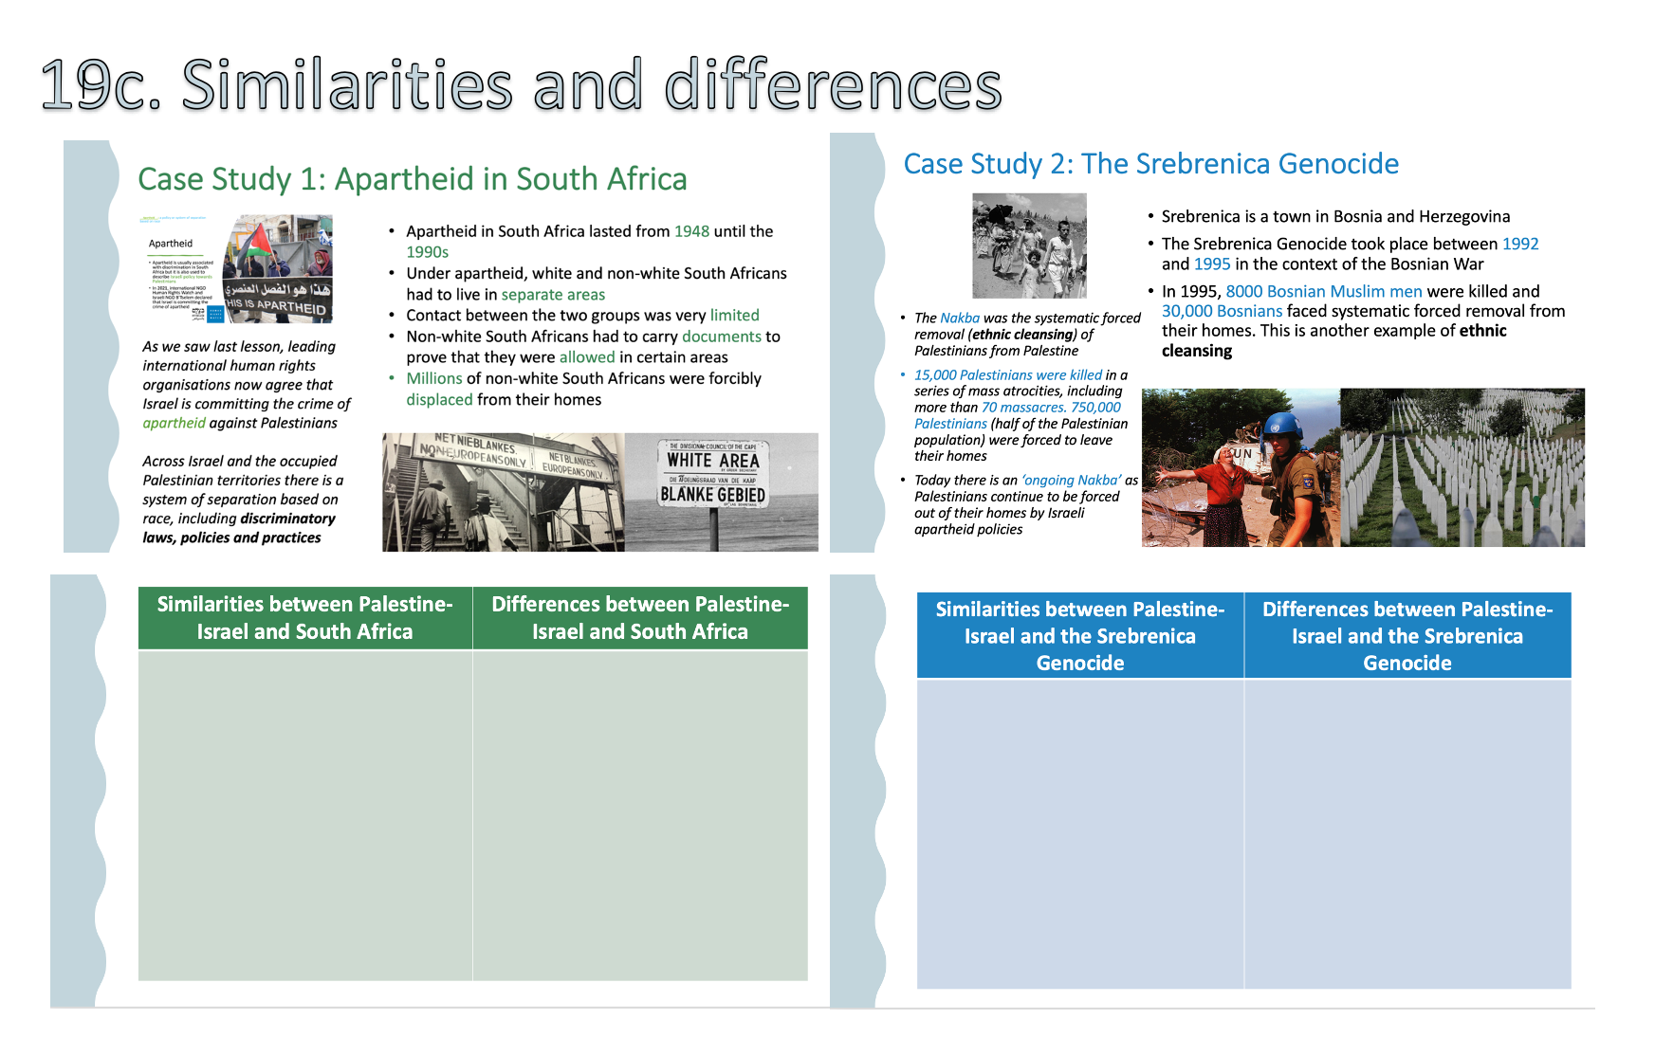
19c. Similarities and differences
Read through the two case studies on your handout:
  Case Study 1: Apartheid in South Africa
  Case Study 2: The Srebrenica Genocide
Using what you now know about the history of Palestine-Israel, what similarities and differences can you identify between South Africa and Srebrenica and Palestine-Israel? Fill in the tables on your handout

Slide 15
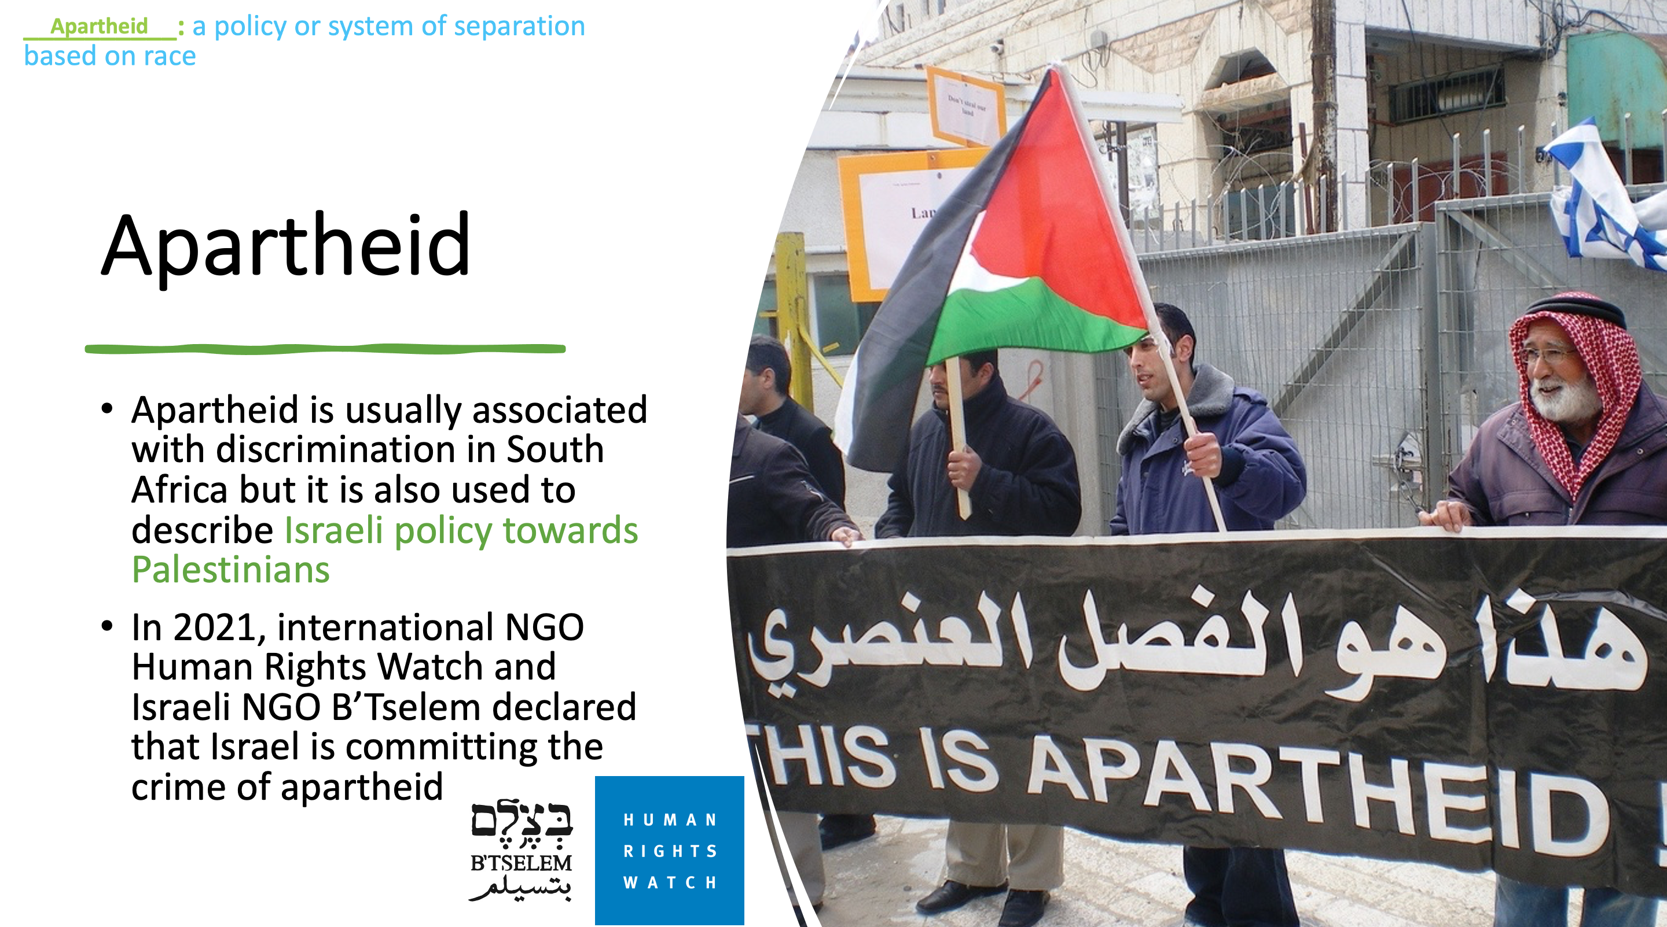
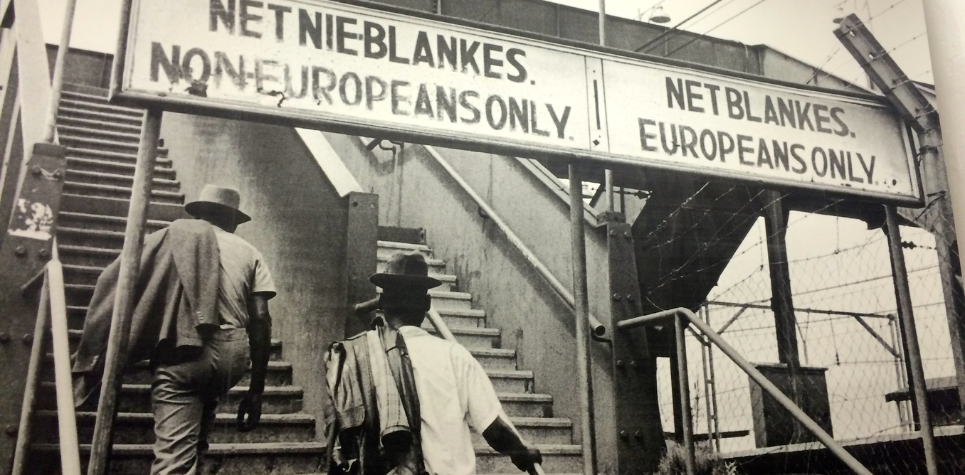
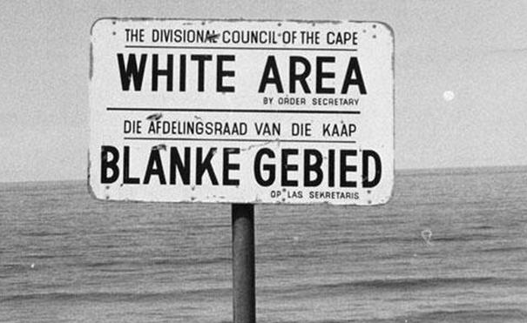
Case Study 1: Apartheid in South Africa
Apartheid in South Africa lasted from 1948 until the 1990s
Under apartheid, white and non-white South Africans had to live in separate areas
Contact between the two groups was very limited
Non-white South Africans had to carry documents to prove that they were allowed in certain areas
Millions of non-white South Africans were forcibly displaced from their homes
As we saw last lesson, leading international human rights organisations now agree that Israel is committing the crime of apartheid against Palestinians
Across Israel and the occupied Palestinian territories there is a system of separation based on race, including discriminatory laws, policies and practices

Slide 16
Similarities between Palestine-Israel and South Africa | Differences between Palestine-Israel and South Africa

Slide 17
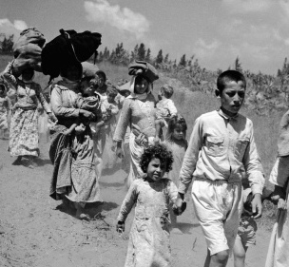
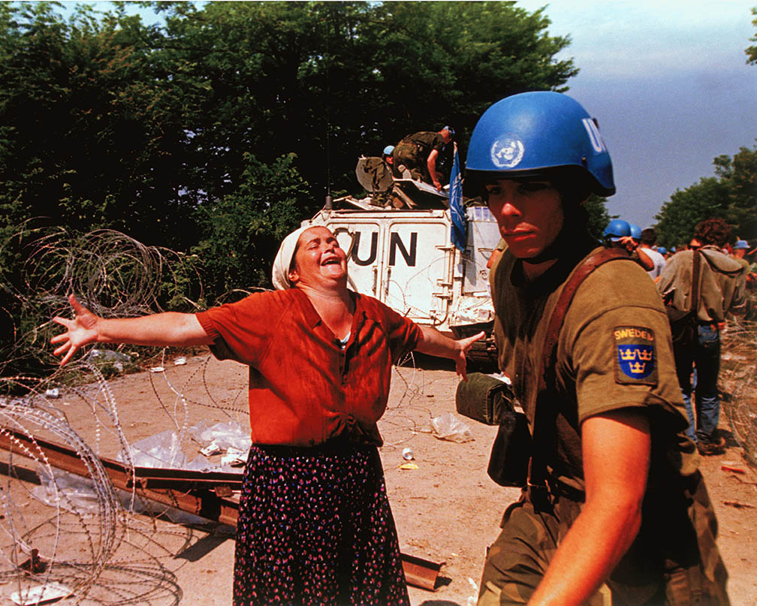
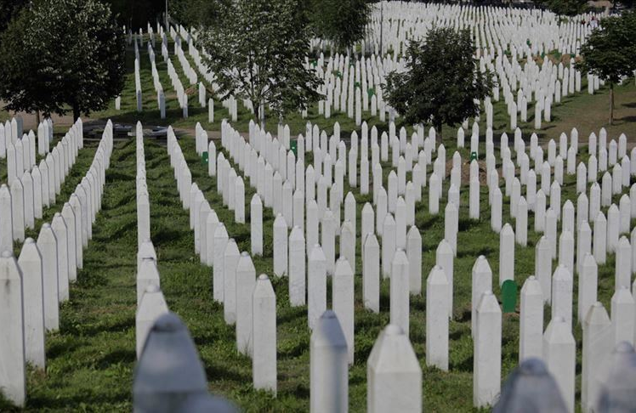
Case Study 2: The Srebrenica Genocide
Srebrenica is a town in Bosnia and Herzegovina
The Srebrenica Genocide took place between 1992 and 1995 in the context of the Bosnian War
In 1995, 8000 Bosnian Muslim men were killed and 30,000 Bosnians faced systematic forced removal from their homes. This is another example of ethnic cleansing
The Nakba was the systematic forced removal (ethnic cleansing) of Palestinians from Palestine
15,000 Palestinians were killed in a series of mass atrocities, including more than 70 massacres. 750,000 Palestinians (half of the Palestinian population) were forced to leave their homes
Today there is an ‘ongoing Nakba’ as Palestinians continue to be forced out of their homes by Israeli apartheid policies

Slide 18
Similarities between Palestine-Israel and the Srebrenica Genocide | Differences between Palestine-Israel and the Srebrenica Genocide

Slide 19
What other comparisons can we draw with Palestine-Israel?
The Rwandan Genocide
  Between April and July 1994 in the context of the Rwandan Civil War, 800,000 individuals (mostly Tutsis) were killed (ethnically cleansed) in around 100 days
America has occupied Cuba since 1959
The UAE has occupied Yemen since 2018
Discrimination
Occupation
Apartheid
Ethnic cleansing
Settlements
Racism

Slide 20
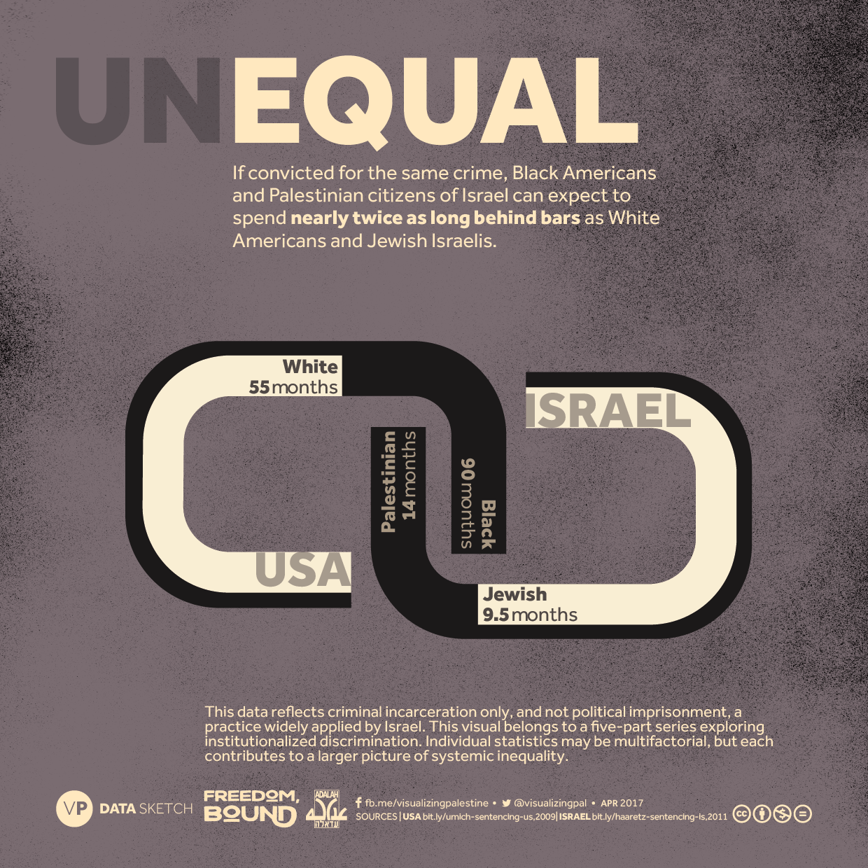
Parallels between Palestinians and Black Americans
Black Americans and Palestinian citizens of Israel are…
  three times more likely to live in poverty than White Americans and Jewish Israelis
  one third less likely to gain a college education than White Americans and Jewish Israelis
  significantly more likely to be unemployed than White Americans and Jewish Israelis
On average, Black Americans and Palestinian citizens of Israel receive one quarter less annual income than White Americans and Jewish Israelis

Slide 21
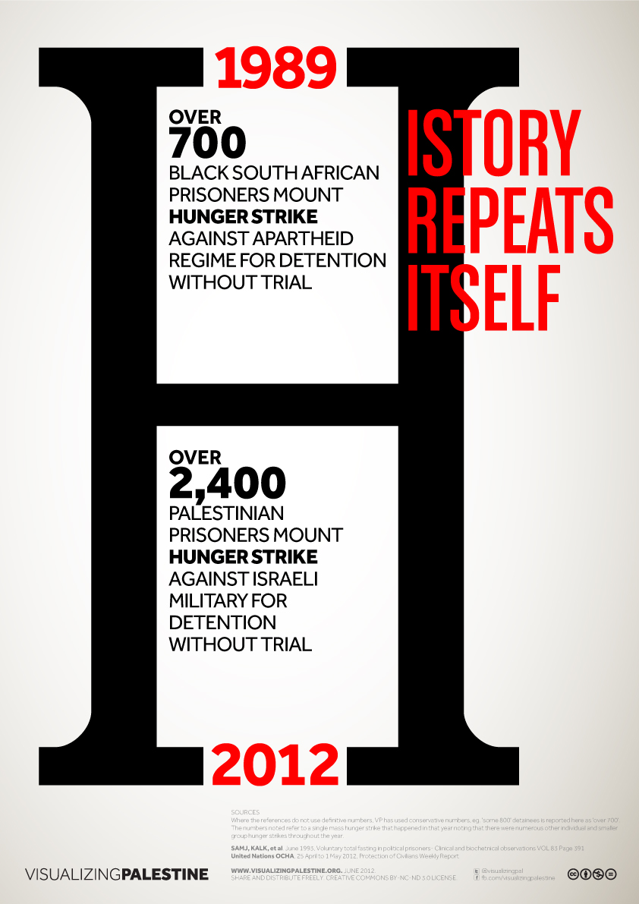

Slide 22
Debate
Can the situation in Palestine-Israel be compared to other places or is it exceptional?
You are going to be assigned a partner. You and your partner are either ‘comparable’ or ‘exceptional’. You can spend a few minutes preparing your argument
Then you will join with another pair and have a debate
Note down any good points made by the other side

Slide 23
How did you find this activity?
Do you think Palestine-Israel is comparable or exceptional?
What was the best point you made?
What was the best point made by the other side?

Slide 24





19d. Plenary
Stick this sheet into your book and fill in the boxes:
HEAD – something that made you THINK today:
HEART – something you have FELT in today’s lesson:
BIN – something you did not find interesting:
BAG – something you will take away from today’s lesson:

Slide 25
Homework
Write one paragraph answering this question:
Is the situation in Palestine-Israel exceptional?
Exceptional: unusual; not typical

